Slide 1
Chapter 6: Formal Relational Query Languages

Slide 2
Chapter 6: Formal Relational Query Languages
Relational Algebra
Tuple Relational Calculus
Domain Relational Calculus

Slide 3
Relational Algebra
Procedural language
Six basic operators
select: σ
project: ∏
union: ∪
set difference: –
Cartesian product: x
rename: ρ
The operators take one or two relations as inputs and produce a new relation as a result.

Slide 4
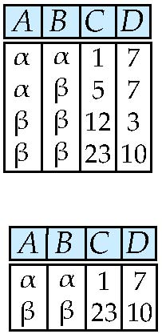
Select Operation – Example
Relation r
σ_{A=B ^ D > 5} (r)

Slide 5
Select Operation
Notation: σ _{p}(r)
p is called the selection predicate
Defined as: σ_{p}(r) = {t | t ∈ r and p(t)}
Where p is a formula in propositional calculus consisting of terms connected by : ∧ (and), ∨ (or), ¬ (not) Each term is one of:
<attribute> op <attribute> or <constant>
where op is one of: =, ≠, >, ≥. <. ≤
Example of selection: σ _{dept_name=“Physics”}(instructor)

Slide 6
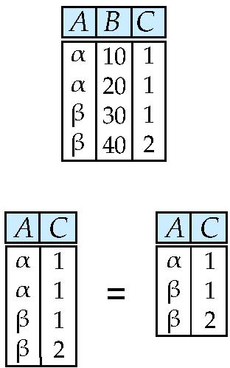
Project Operation – Example
Relation r:
∏_{A,C} (r)

Slide 7
Project Operation
Notation:
where A₁, A₂ are attribute names and r is a relation name.
The result is defined as the relation of k columns obtained by erasing the columns that are not listed
Duplicate rows removed from result, since relations are sets
Example: To eliminate the dept_name attribute of instructor ∏_{ID, name, salary} (instructor)

Slide 8
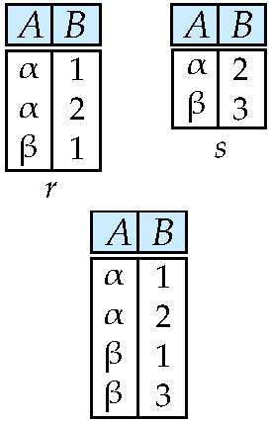
Union Operation – Example
Relations r, s:
r ∪ s:

Slide 9
Union Operation
Notation: r ∪ s
Defined as:
r ∪ s = {t | t ∈ r or t ∈ s}
For r ∪ s to be valid.
1. r, s must have the same arity (same number of attributes)
2. The attribute domains must be compatible (example: 2nd column of r deals with the same type of values as does the 2nd column of s)
Example: to find all courses taught in the Fall 2009 semester, or in the Spring 2010 semester, or in both ∏_{course_id} (σ _{semester=“Fall” Λ year=2009} (section)) ∪ ∏_{course_id} (σ _{semester=“Spring” Λ year=2010} (section))

Slide 10
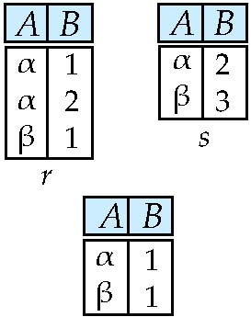
Set difference of two relations
Relations r, s:
r – s:

Slide 11
Set Difference Operation
Notation r – s
Defined as:
r – s = {t | t ∈ r and t ∉ s}
Set differences must be taken between compatible relations.
r and s must have the same arity
attribute domains of r and s must be compatible
Example: to find all courses taught in the Fall 2009 semester, but not in the Spring 2010 semester ∏_{course_id} (σ _{semester=“Fall” Λ year=2009} (section)) − ∏_{course_id} (σ _{semester=“Spring” Λ year=2010} (section))

Slide 12
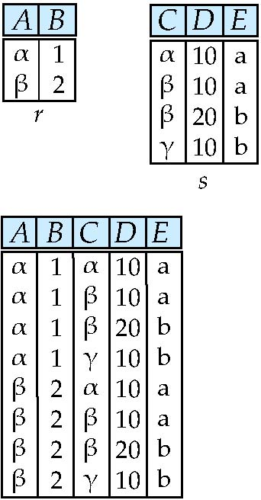
Cartesian-Product Operation – Example
Relations r, s:
r x s:

Slide 13
Cartesian-Product Operation
Notation r x s
Defined as:
r x s = {t q | t ∈ r and q ∈ s}
Assume that attributes of r(R) and s(S) are disjoint. (That is, R ∩ S = ∅).
If attributes of r(R) and s(S) are not disjoint, then renaming must be used.

Slide 14
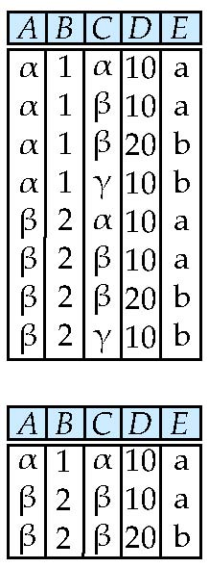
Composition of Operations
Can build expressions using multiple operations
Example: σ_{A=C}(r x s)
r x s
σ_{A=C}(r x s)

Slide 15
Rename Operation
Allows us to name, and therefore to refer to, the results of relational-algebra expressions.
Allows us to refer to a relation by more than one name.
Example:
ρ _{x} (E)
returns the expression E under the name X
If a relational-algebra expression E has arity n, then
returns the result of expression E under the name X, and with the
attributes renamed to A₁ , A₂ , …., A_{n} .

Slide 16
Example Query
Find the largest salary in the university
Step 1: find instructor salaries that are less than some other instructor salary (i.e. not maximum)
using a copy of instructor under a new name d
∏_{instructor.salary} (σ _{instructor.salary < d.salary} (instructor x ρ_{d} (instructor)))
Step 2: Find the largest salary
∏_{salary} (instructor) – ∏_{instructor.salary} (σ _{instructor.salary < d.salary} (instructor x ρ_{d} (instructor)))

Slide 17
Example Queries
Find the names of all instructors in the Physics department, along with the course_id of all courses they have taught
Query 1 ∏_{instructor.ID,course_id} (σ_{dept_name=“Physics”} ( σ _{instructor.ID=teaches.ID} (instructor x teaches)))
Query 2 ∏_{instructor.ID,course_id} (σ_{instructor.ID=teaches.ID} ( σ _{dept_name=“Physics”} (instructor) x teaches))

Slide 18
Formal Definition
A basic expression in the relational algebra consists of either one of the following:
A relation in the database
A constant relation
Let E₁ and E₂ be relational-algebra expressions; the following are all relational-algebra expressions:
E₁ ∪ E₂
E₁ – E₂
E₁ x E₂
σ_{p} (E₁), P is a predicate on attributes in E₁
∏_{s}(E₁), S is a list consisting of some of the attributes in E₁
ρ _{x} (E₁), x is the new name for the result of E₁

Slide 19
Additional Operations
We define additional operations that do not add any power to the
relational algebra, but that simplify common queries.
Set intersection
Natural join
Assignment
Outer join

Slide 20
Set-Intersection Operation
Notation: r ∩ s
Defined as:
r ∩ s = { t | t ∈ r and t ∈ s }
Assume:
r, s have the same arity
attributes of r and s are compatible
Note: r ∩ s = r – (r – s)

Slide 21
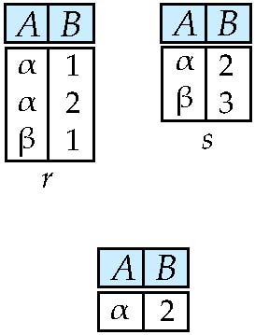
Set-Intersection Operation – Example
Relation r, s:
r ∩ s

Slide 22
Natural-Join Operation
Notation: r s
Let r and s be relations on schemas R and S respectively. Then, r s is a relation on schema R ∪ S obtained as follows:
Example:
R = (A, B, C, D)
S = (E, B, D)
Result schema = (A, B, C, D, E)
r s is defined as: ∏_{r.A, r.B, r.C, r.D, s.E} (σ_{r.B = s.B ∧ r.D = s.D} (r x s))

Slide 23
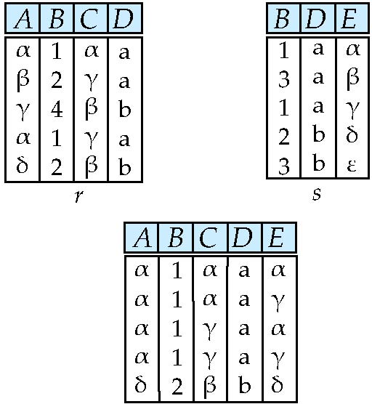
Natural Join Example
Relations r, s:
r s

Slide 24
Natural Join and Theta Join
Find the names of all instructors in the Comp. Sci. department together with the course titles of all the courses that the instructors teach
∏ _{name, title} (σ _{dept_name=“Comp. Sci.”} (instructor teaches course))
Natural join is associative
(instructor teaches) course is equivalent to instructor (teaches course)
Natural join is commutative
instruct teaches is equivalent to teaches instructor
The theta join operation r _{θ} s is defined as
r _{θ} s = σ_{θ} (r x s)

Slide 25
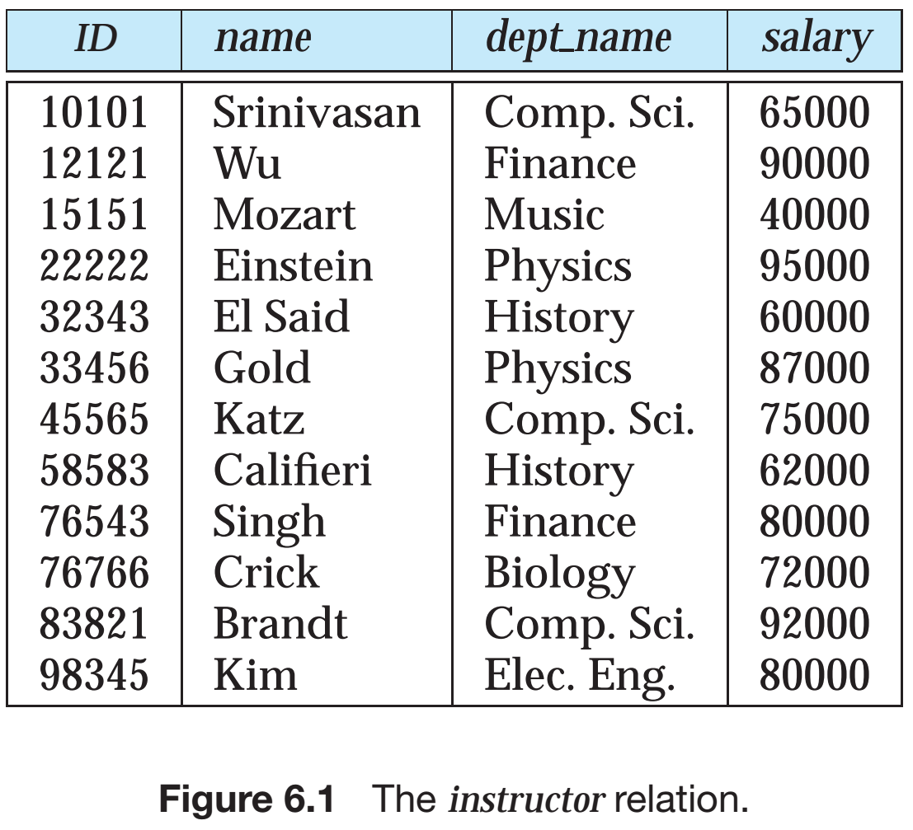
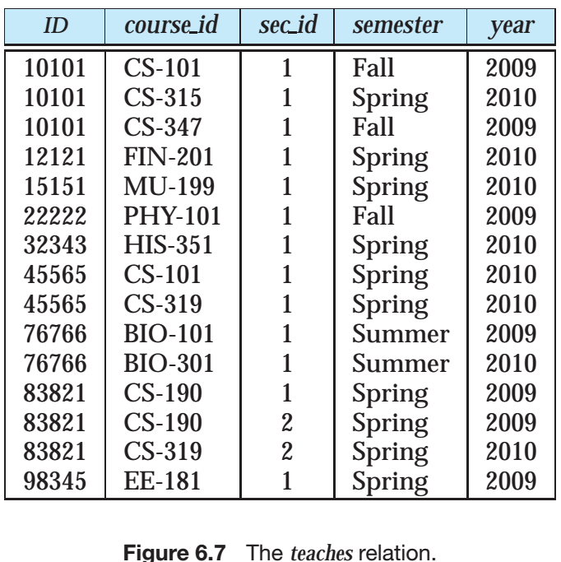
Natural Join Example

Slide 26
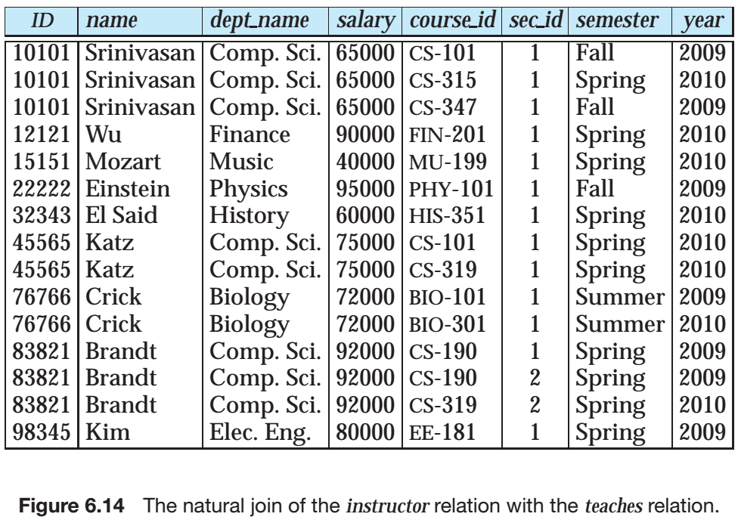
Natural Join Example

Slide 27
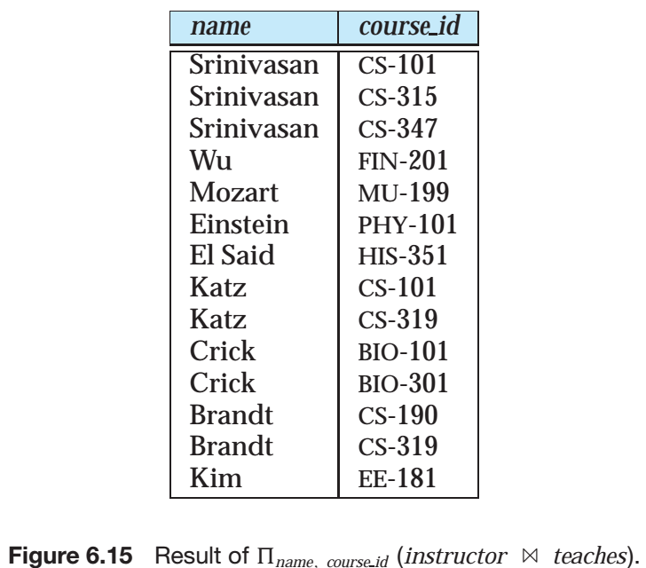
Natural Join Example

Slide 28
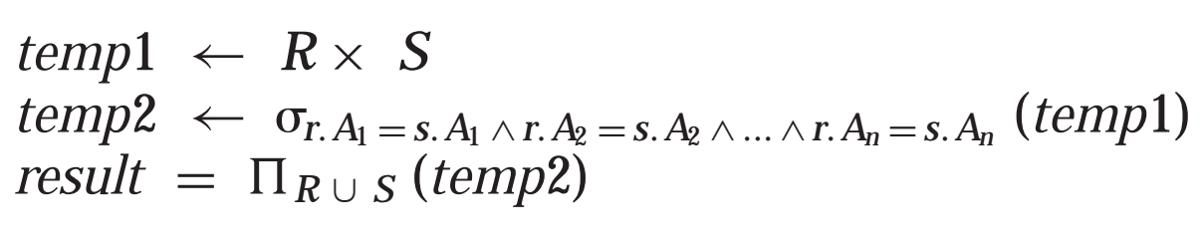
Assignment Operation
The assignment operation (←) provides a convenient way to express complex queries.
Write query as a sequential program consisting of
a series of assignments
followed by an expression whose value is displayed as a result of the query.
Assignment must always be made to a temporary relation variable.
Example: we could write R S as:

Slide 29
Outer Join
An extension of the join operation that avoids loss of information.
Computes the join and then adds tuples form one relation that does not match tuples in the other relation to the result of the join.
Uses null values:
null signifies that the value is unknown or does not exist
All comparisons involving null are (roughly speaking) false by definition.
We shall study precise meaning of comparisons with nulls later

Slide 30
Outer Join – Example
Relation instructor1
ID
name
dept_name
10101
12121
15151
Srinivasan
Wu
Mozart
Comp. Sci.
Finance
Music
Relation teaches1
ID
course_id
10101
12121
76766
CS-101
FIN-201
BIO-101

Slide 31
Outer Join – Example
Join instructor teaches
ID
name
dept_name
course_id
10101
12121
Srinivasan
Wu
Comp. Sci.
Finance
CS-101
FIN-201
Left Outer Join
instructor teaches
ID
name
dept_name
course_id
10101
12121
15151
Srinivasan
Wu
Mozart
Comp. Sci.
Finance
Music
CS-101
FIN-201
null

Slide 32
Outer Join – Example
Right Outer Join
instructor teaches
ID
name
dept_name
course_id
10101
12121
76766
Srinivasan
Wu
null
Comp. Sci.
Finance
null
CS-101
FIN-201
BIO-101
Full Outer Join
instructor teaches
ID
name
dept_name
course_id
10101
12121
15151
76766
Srinivasan
Wu
Mozart
null
Comp. Sci.
Finance
Music
null
CS-101
FIN-201
null
BIO-101

Slide 33
Outer Join using Joins
Outer join can be expressed using basic operations
e.g. r s can be written as
(r s) U (r – ∏_{R}(r s) x {(null, …, null)}

Slide 34
Null Values
It is possible for tuples to have a null value, denoted by null, for some of their attributes
null signifies an unknown value or that a value does not exist.
The result of any arithmetic expression involving null is null.
Aggregate functions simply ignore null values (as in SQL)
For duplicate elimination and grouping, null is treated like any other value, and two nulls are assumed to be the same (as in SQL)

Slide 35
Null Values
Comparisons with null values return the special truth value: unknown
If false was used instead of unknown, then not (A < 5) would not be equivalent to A >= 5
Three-valued logic using the truth value unknown:
OR: (unknown or true) = true, (unknown or false) = unknown (unknown or unknown) = unknown
AND: (true and unknown) = unknown, (false and unknown) = false, (unknown and unknown) = unknown
NOT: (not unknown) = unknown
In SQL “P is unknown” evaluates to true if predicate P evaluates to unknown
Result of select predicate is treated as false if it evaluates to unknown

Slide 36
Division Operator
Given relations r(R) and s(S), such that S ⊂ R, r ÷ s is the largest relation t(R-S) such that t x s ⊆ r
E.g. let r(ID, course_id) = ∏_{ID, course_id} (takes ) and s(course_id) = ∏_{course_id} (σ_{dept_name=“Biology”}(course ) then r ÷ s gives us students who have taken all courses in the Biology department
Can write r ÷ s as
temp1 ← ∏_{R-S} (r ) temp2 ← ∏_{R-S} ((temp1 x s ) – ∏_{R-S,S} (r )) result = temp1 – temp2
The result to the right of the ← is assigned to the relation variable on the left of the ←.
May use variable in subsequent expressions.

Slide 37
Extended Relational-Algebra-Operations
Generalized Projection
Aggregate Functions

Slide 38
Generalized Projection
Extends the projection operation by allowing arithmetic functions to be used in the projection list.
E is any relational-algebra expression
Each of F₁, F₂, …, F_{n} are are arithmetic expressions involving constants and attributes in the schema of E.
Given relation instructor(ID, name, dept_name, salary) where salary is annual salary, get the same information but with monthly salary
∏_{ID, name, dept_name, salary/12} (instructor)

Slide 39

Aggregate Functions and Operations
Aggregation function takes a collection of values and returns a single value as a result.
avg: average value min: minimum value max: maximum value sum: sum of values count: number of values
Aggregate operation in relational algebra
E is any relational-algebra expression
G₁, G₂ …, G_{n} is a list of attributes on which to group (can be empty)
Each F_{i} is an aggregate function
Each A_{i} is an attribute name
Note: Some books/articles use γ instead of (Calligraphic G)

Slide 40
Aggregate Operation – Example
Relation r:
A
B
C
α
α
β
β
α
β
β
β
7
7
3
10
_{sum(c)} (r)
sum(c )
27

Slide 41
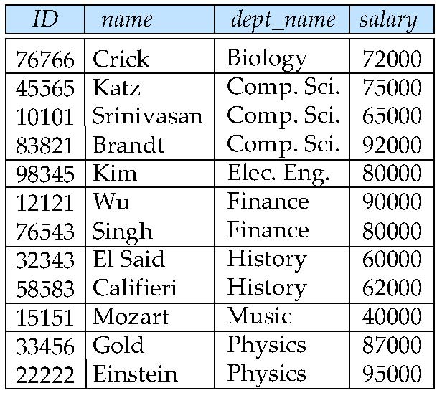
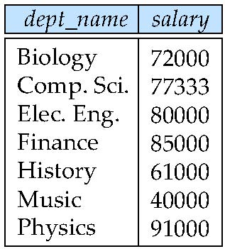
Aggregate Operation – Example
Find the average salary in each department
_{dept_name} _{avg(salary)} (instructor)
avg_salary

Slide 42
Aggregate Functions (Cont.)
Result of aggregation does not have a name
Can use rename operation to give it a name
For convenience, we permit renaming as part of aggregate operation
_{dept_name} _{avg(salary) as avg_sal} (instructor)

Slide 43
Modification of the Database
The content of the database may be modified using the following operations:
Deletion
Insertion
Updating
All these operations can be expressed using the assignment operator

Slide 44
Multiset Relational Algebra
Pure relational algebra removes all duplicates
e.g. after projection
Multiset relational algebra retains duplicates, to match SQL semantics
SQL duplicate retention was initially for efficiency, but is now a feature
Multiset relational algebra defined as follows
selection: has as many duplicates of a tuple as in the input, if the tuple satisfies the selection
projection: one tuple per input tuple, even if it is a duplicate
cross product: If there are m copies of t1 in r, and n copies of t2 in s, there are m x n copies of t1.t2 in r x s
Other operators similarly defined
E.g. union: m + n copies, intersection: min(m, n) copies difference: min(0, m – n) copies

Slide 45
SQL and Relational Algebra
select A1, A2, .. An from r1, r2, …, rm where P
is equivalent to the following expression in multiset relational algebra
∏ _{A1, .., An} (σ _{P} (r1 x r2 x .. x rm))
select A1, A2, sum(A3) from r1, r2, …, rm where P group by A1, A2
is equivalent to the following expression in multiset relational algebra
_{A1, A2} _{sum(A3)} (σ _{P} (r1 x r2 x .. x rm)))

Slide 46
SQL and Relational Algebra
More generally, the non-aggregated attributes in the select clause may be a subset of the group by attributes, in which case the equivalence is as follows: select A1, sum(A3) from r1, r2, …, rm where P group by A1, A2
is equivalent to the following expression in multiset relational algebra
∏ _{A1,sumA3}( _{A1,A2} _{sum(A3)} _{as sumA3}(σ _{P} (r1 x r2 x .. x rm)))

Slide 47
Tuple Relational Calculus

Slide 48
Tuple Relational Calculus
A nonprocedural query language, where each query is of the form
{t | P (t ) }
It is the set of all tuples t such that predicate P is true for t
t is a tuple variable, t [A ] denotes the value of tuple t on attribute A
t ∈ r denotes that tuple t is in relation r
P is a formula similar to that of the predicate calculus

Slide 49
Predicate Calculus Formula
1. Set of attributes and constants
2. Set of comparison operators: (e.g., <, ≤, =, ≠, >, ≥)
3. Set of connectives: and (∧), or (v)‚ not (¬)
4. Implication (⇒): x ⇒ y, if x if true, then y is true
x ⇒ y ≡ ¬x v y
5. Set of quantifiers:
∃ t ∈ r (Q (t )) ≡ ”there exists” a tuple in t in relation r such that predicate Q (t ) is true
∀t ∈ r (Q (t )) ≡ Q is true “for all” tuples t in relation r

Slide 50
Example Queries
Find the ID, name, dept_name, salary for instructors whose salary is greater than $80,000
{t | t ∈ instructor ∧ t [salary ] > 80000}
As in the previous query, but output only the ID attribute value
{t | ∃ s ∈ instructor (t [ID ] = s [ID ] ∧ s [salary ] > 80000)}
Notice that a relation on schema (ID) is implicitly defined by
the query

Slide 51
Example Queries
Find the names of all instructors whose department is in the Watson building
{t | ∃s ∈ instructor (t [name ] = s [name ] ∧ ∃u ∈ department (u [dept_name ] = s[dept_name] “ ∧ u [building] = “Watson” ))}
Find the set of all courses taught in the Fall 2009 semester, or in the Spring 2010 semester, or both
{t | ∃s ∈ section (t [course_id ] = s [course_id ] ∧ s [semester] = “Fall” ∧ s [year] = 2009 v ∃u ∈ section (t [course_id ] = u [course_id ] ∧ u [semester] = “Spring” ∧ u [year] = 2010)}

Slide 52
Example Queries
Find the set of all courses taught in the Fall 2009 semester, and in the Spring 2010 semester
{t | ∃s ∈ section (t [course_id ] = s [course_id ] ∧ s [semester] = “Fall” ∧ s [year] = 2009 ∧ ∃u ∈ section (t [course_id ] = u [course_id ] ∧ u [semester] = “Spring” ∧ u [year] = 2010)}
Find the set of all courses taught in the Fall 2009 semester, but not in the Spring 2010 semester
{t | ∃s ∈ section (t [course_id ] = s [course_id ] ∧ s [semester] = “Fall” ∧ s [year] = 2009 ∧ ¬ ∃u ∈ section (t [course_id ] = u [course_id ] ∧ u [semester] = “Spring” ∧ u [year] = 2010)}

Slide 53
Safety of Expressions
It is possible to write tuple calculus expressions that generate infinite relations.
For example, { t | ¬ t ∈ r } results in an infinite relation if the domain of any attribute of relation r is infinite
To guard against the problem, we restrict the set of allowable expressions to safe expressions.
An expression {t | P (t )} in the tuple relational calculus is safe if every component of t appears in one of the relations, tuples, or constants that appear in P
NOTE: this is more than just a syntax condition.
E.g. { t | t [A] = 5 ∨ true } is not safe --- it defines an infinite set with attribute values that do not appear in any relation or tuples or constants in P.

Slide 54
Universal Quantification
Find all students who have taken all courses offered in the Biology department
{t | ∃ r ∈ student (t [ID] = r [ID]) ∧ (∀ u ∈ course (u [dept_name]=“Biology” ⇒ ∃ s ∈ takes (t [ID] = s [ID ] ∧ s [course_id] = u [course_id]))}
Note that without the existential quantification on student, the above query would be unsafe if the Biology department has not offered any courses.

Slide 55
Domain Relational Calculus

Slide 56
Domain Relational Calculus
A nonprocedural query language equivalent in power to the tuple relational calculus
Each query is an expression of the form:
{ < x₁, x₂, …, x_{n} > | P (x₁, x₂, …, x_{n})}
x₁, x₂, …, x_{n} represent domain variables
P represents a formula similar to that of the predicate calculus

Slide 57
Example Queries
Find the ID, name, dept_name, salary for instructors whose salary is greater than $80,000
{< i, n, d, s> | < i, n, d, s> ∈ instructor ∧ s > 80000}
As in the previous query, but output only the ID attribute value
{< i> | < i, n, d, s> ∈ instructor ∧ s > 80000}
Find the names of all instructors whose department is in the Watson building
{< n > | ∃ i, d, s (< i, n, d, s > ∈ instructor ∧ ∃ b, a (< d, b, a> ∈ department ∧ b = “Watson” ))}

Slide 58
Example Queries
Find the set of all courses taught in the Fall 2009 semester, or in the Spring 2010 semester, or both
{<c> | ∃ a, s, y, b, r, t ( <c, a, s, y, b, r, t > ∈ section ∧ s = “Fall” ∧ y = 2009 ) v ∃ a, s, y, b, r, t ( <c, a, s, y, b, r, t > ∈ section ] ∧ s = “Spring” ∧ y = 2010)}
This case can also be written as {<c> | ∃ a, s, y, b, r, t ( <c, a, s, y, b, r, t > ∈ section ∧ ( (s = “Fall” ∧ y = 2009 ) v (s = “Spring” ∧ y = 2010))}
Find the set of all courses taught in the Fall 2009 semester, and in the Spring 2010 semester
{<c> | ∃ a, s, y, b, r, t ( <c, a, s, y, b, r, t > ∈ section ∧ s = “Fall” ∧ y = 2009 ) ∧ ∃ a, s, y, b, r, t ( <c, a, s, y, b, r, t > ∈ section ] ∧ s = “Spring” ∧ y = 2010)}

Slide 59
Safety of Expressions
The expression:
{ < x₁, x₂, …, x_{n} > | P (x₁, x₂, …, x_{n} )}
is safe if all of the following hold:
All values that appear in tuples of the expression are values from dom (P ) (that is, the values appear either in P or in a tuple of a relation mentioned in P ).
For every “there exists” subformula of the form ∃ x (P₁(x )), the subformula is true if and only if there is a value of x in dom (P₁) such that P₁(x ) is true.
For every “for all” subformula of the form ∀_{x} (P₁ (x )), the subformula is true if and only if P₁(x ) is true for all values x from dom (P₁).

Slide 60
Universal Quantification
Find all students who have taken all courses offered in the Biology department
{< i > | ∃ n, d, tc ( < i, n, d, tc > ∈ student ∧ (∀ ci, ti, dn, cr ( < ci, ti, dn, cr > ∈ course ∧ dn =“Biology” ⇒ ∃ si, se, y, g ( <i, ci, si, se, y, g> ∈ takes ))}
Note that without the existential quantification on student, the above query would be unsafe if the Biology department has not offered any courses.
* Above query fixes bug in page 246, last query

Slide 61
End of Chapter 6

Slide 62
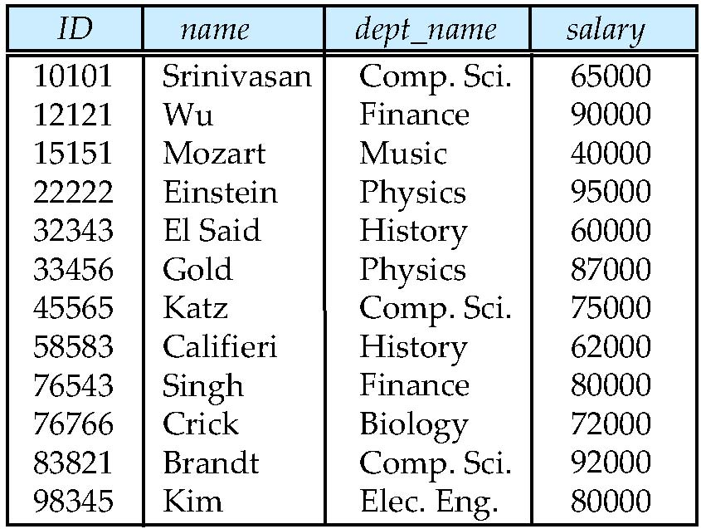
Figure 6.01

Slide 63
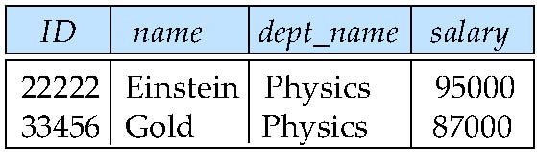
Figure 6.02

Slide 64
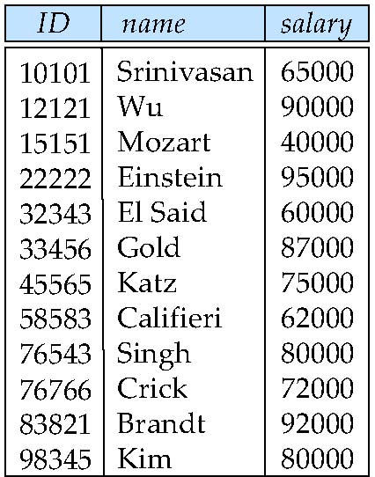
Figure 6.03

Slide 65
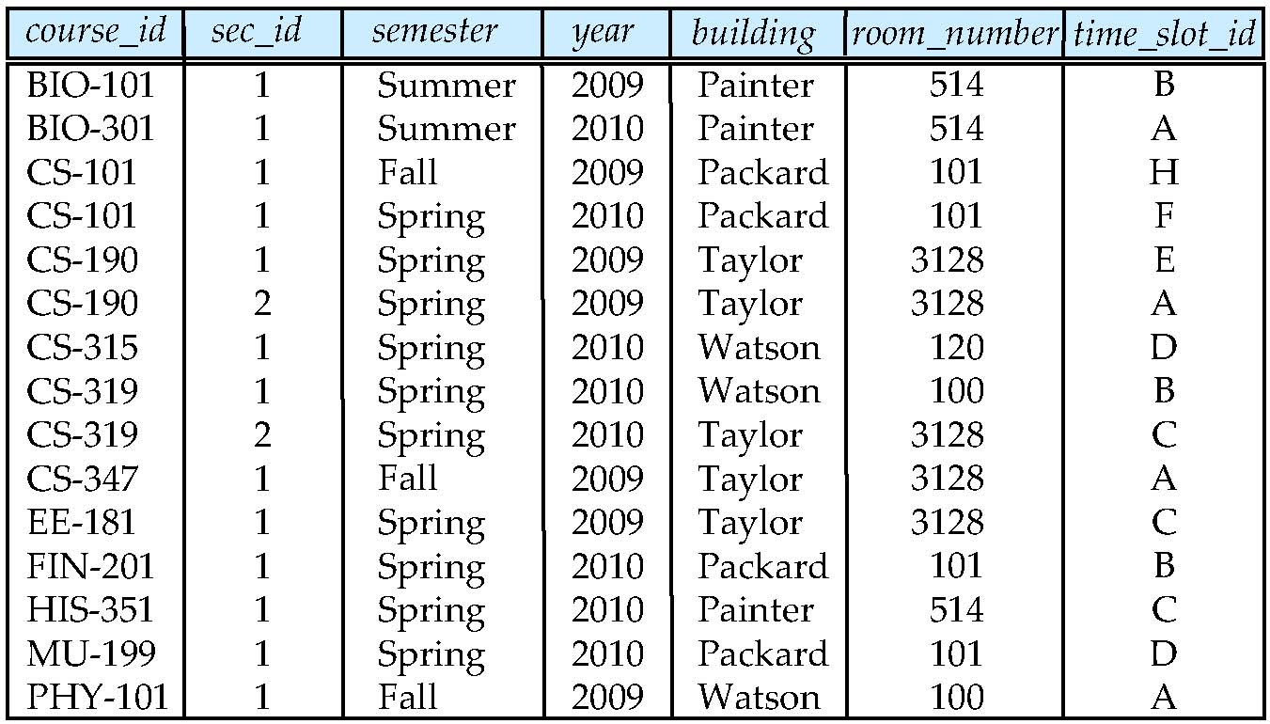
Figure 6.04

Slide 66
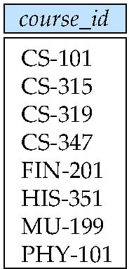
Figure 6.05

Slide 67
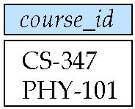
Figure 6.06

Slide 68
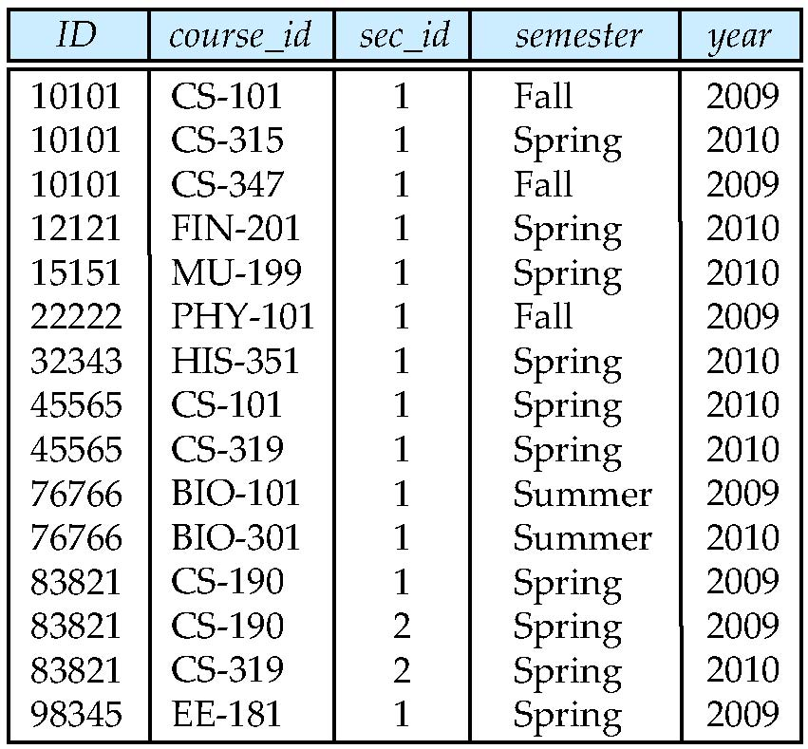
Figure 6.07

Slide 69
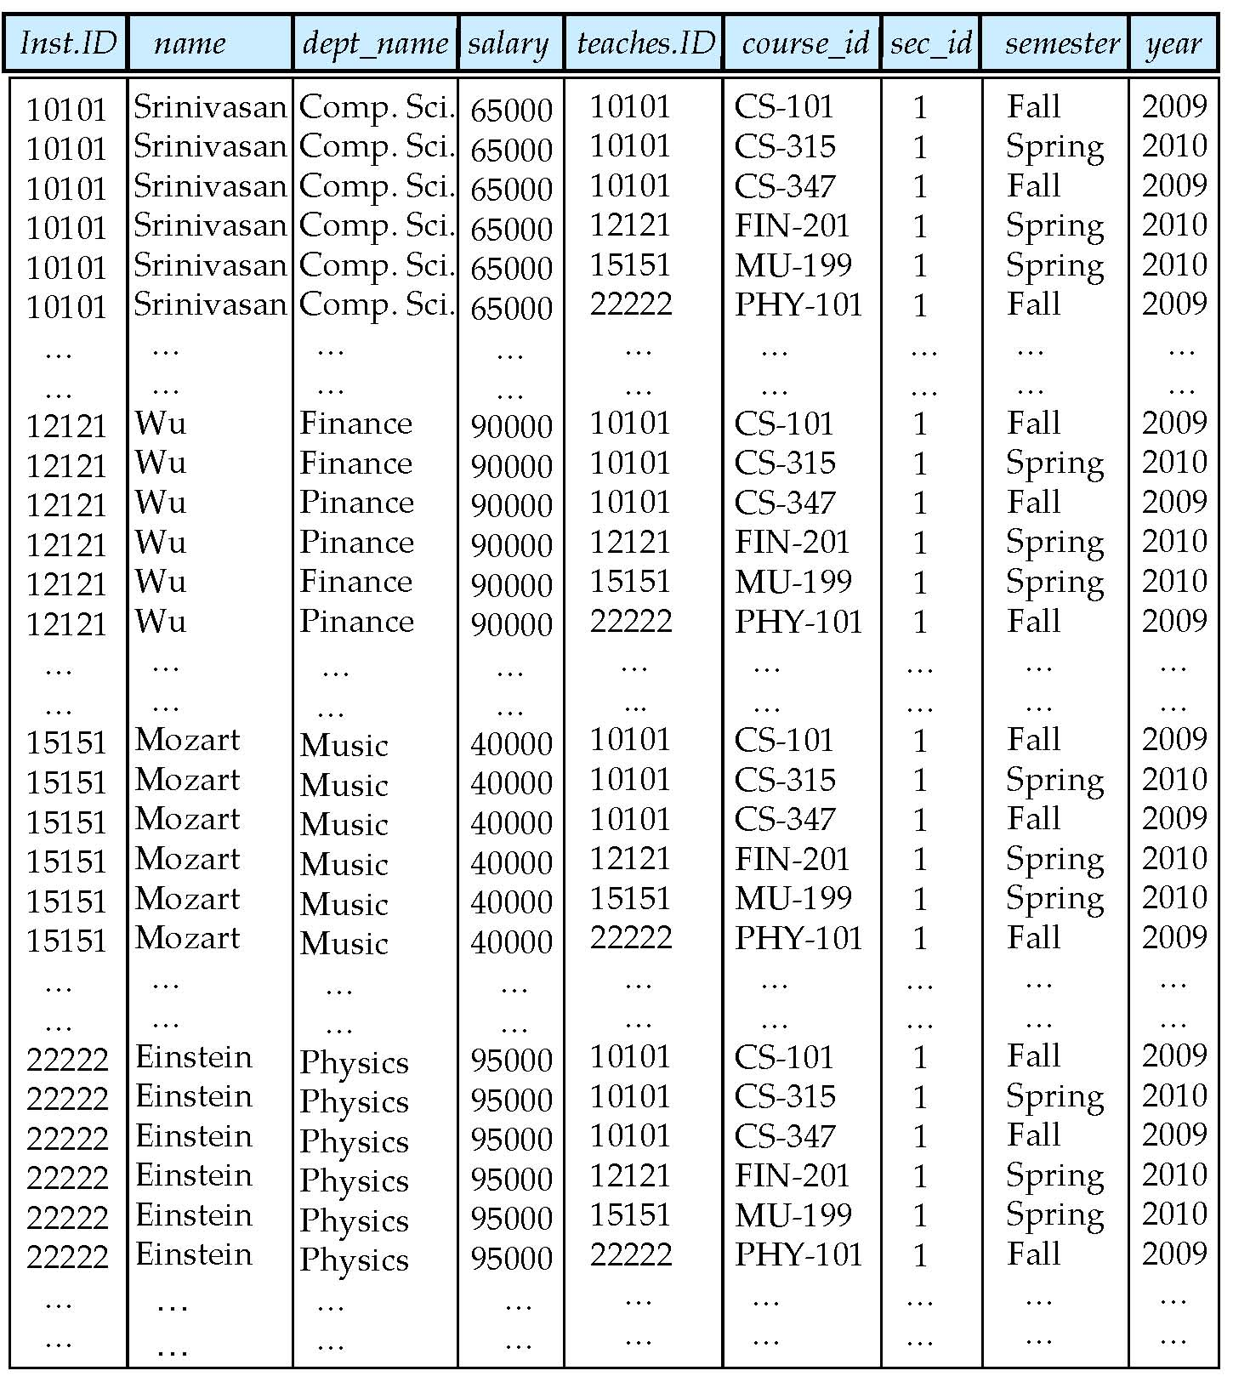
Figure 6.08

Slide 70
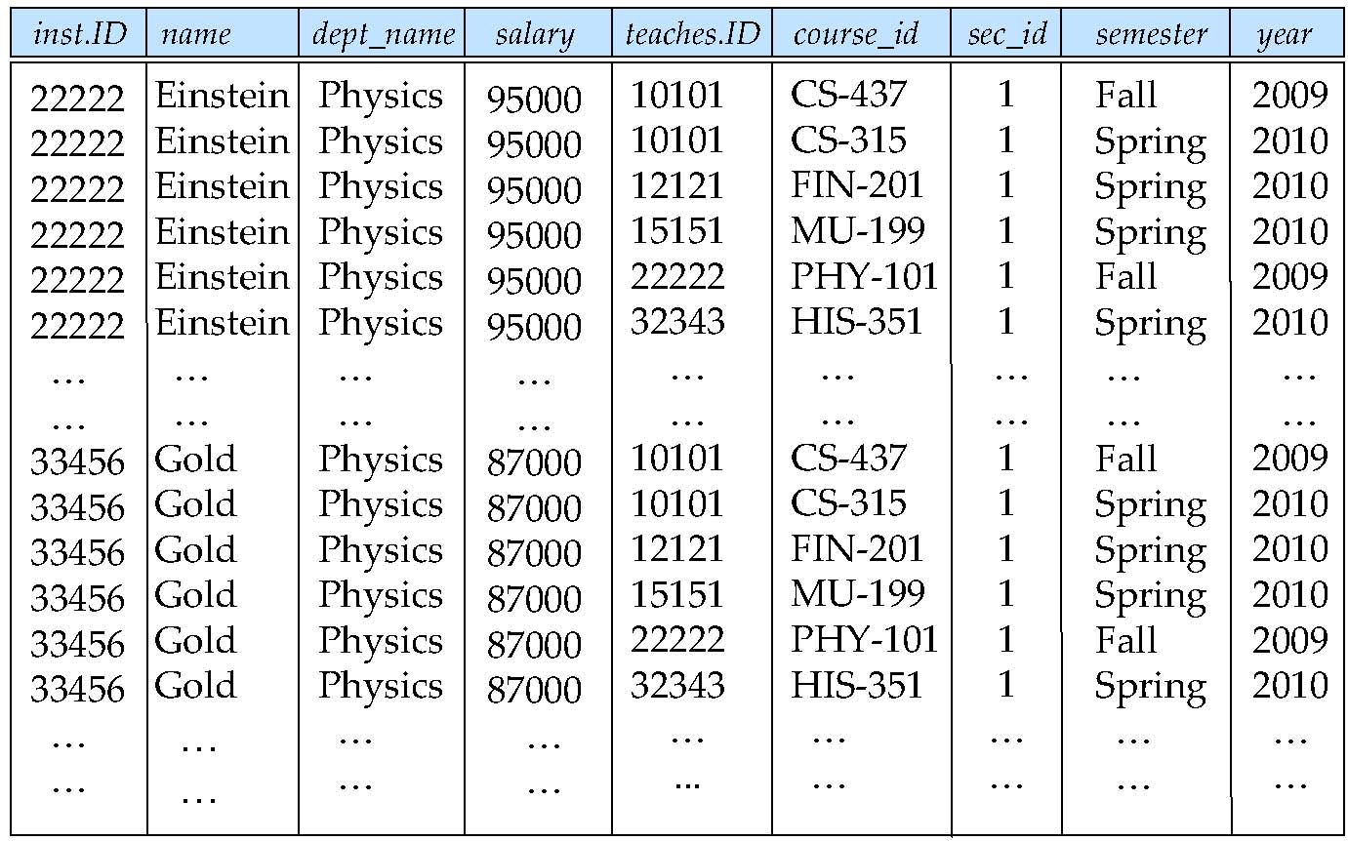
Figure 6.09

Slide 71
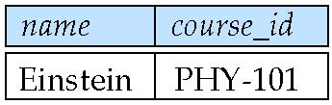
Figure 6.10

Slide 72
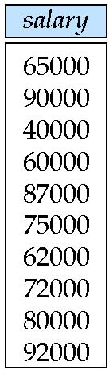
Figure 6.11

Slide 73
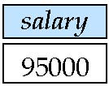
Figure 6.12

Slide 74
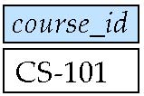
Figure 6.13

Slide 75
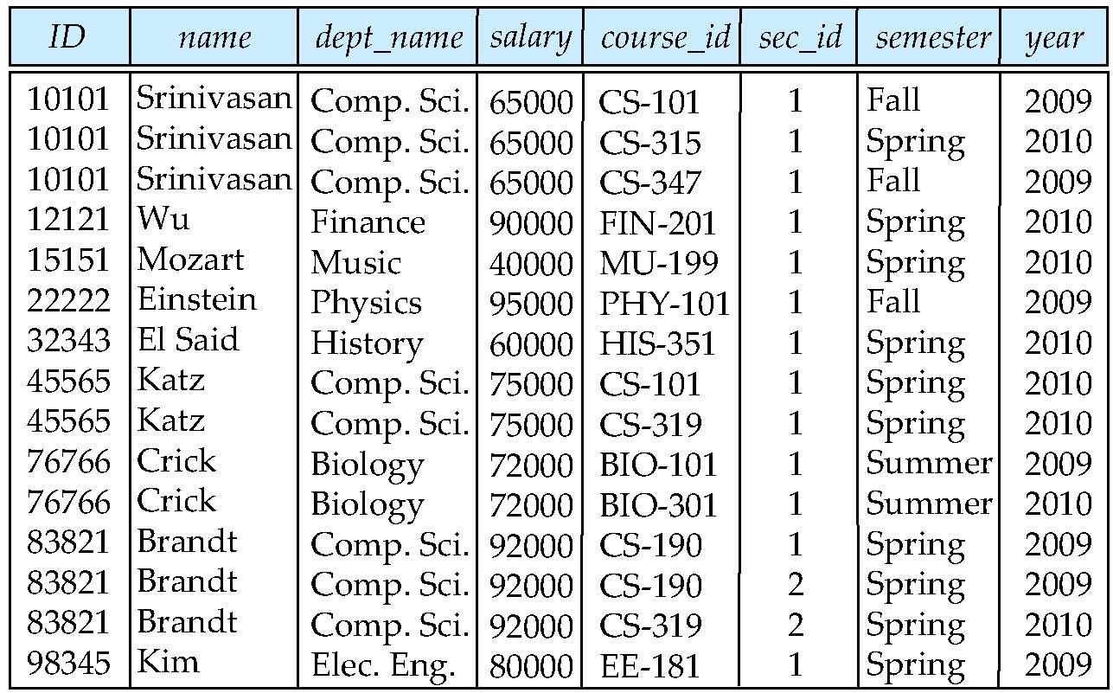
Figure 6.14

Slide 76
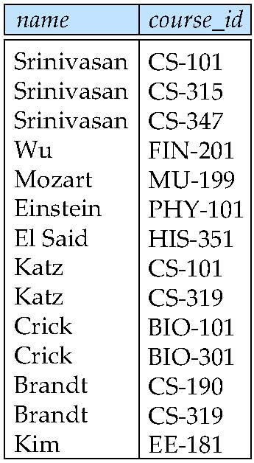
Figure 6.15

Slide 77
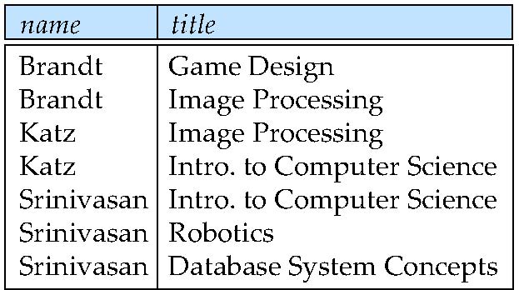
Figure 6.16

Slide 78
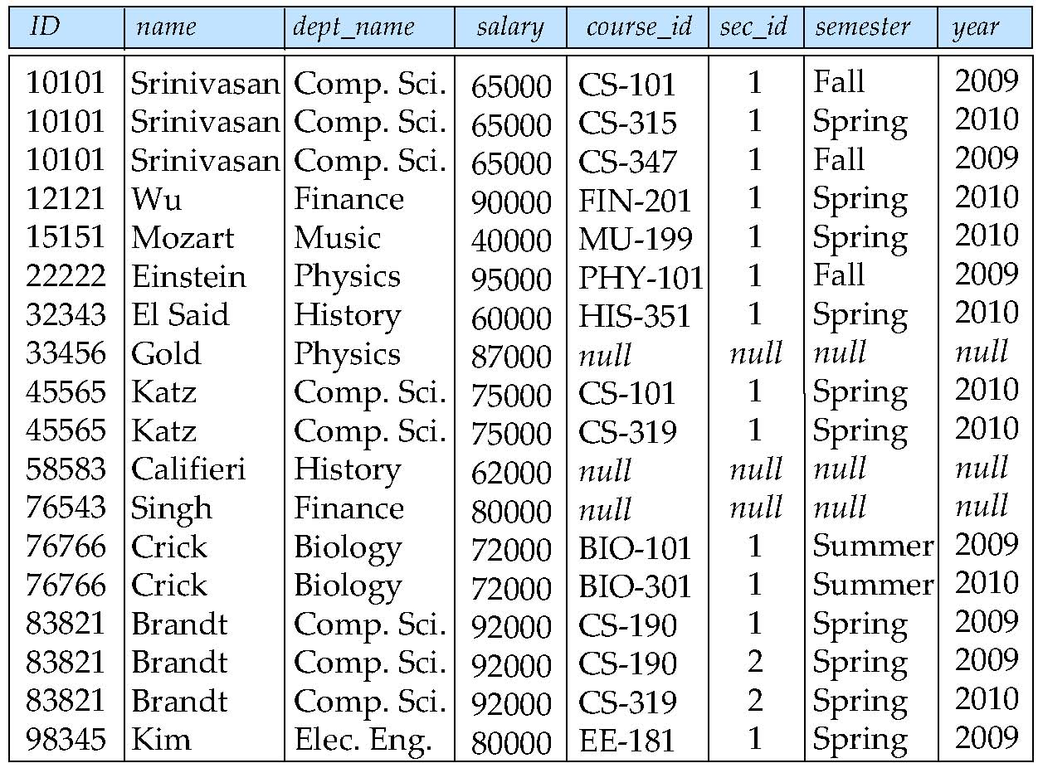
Figure 6.17

Slide 79
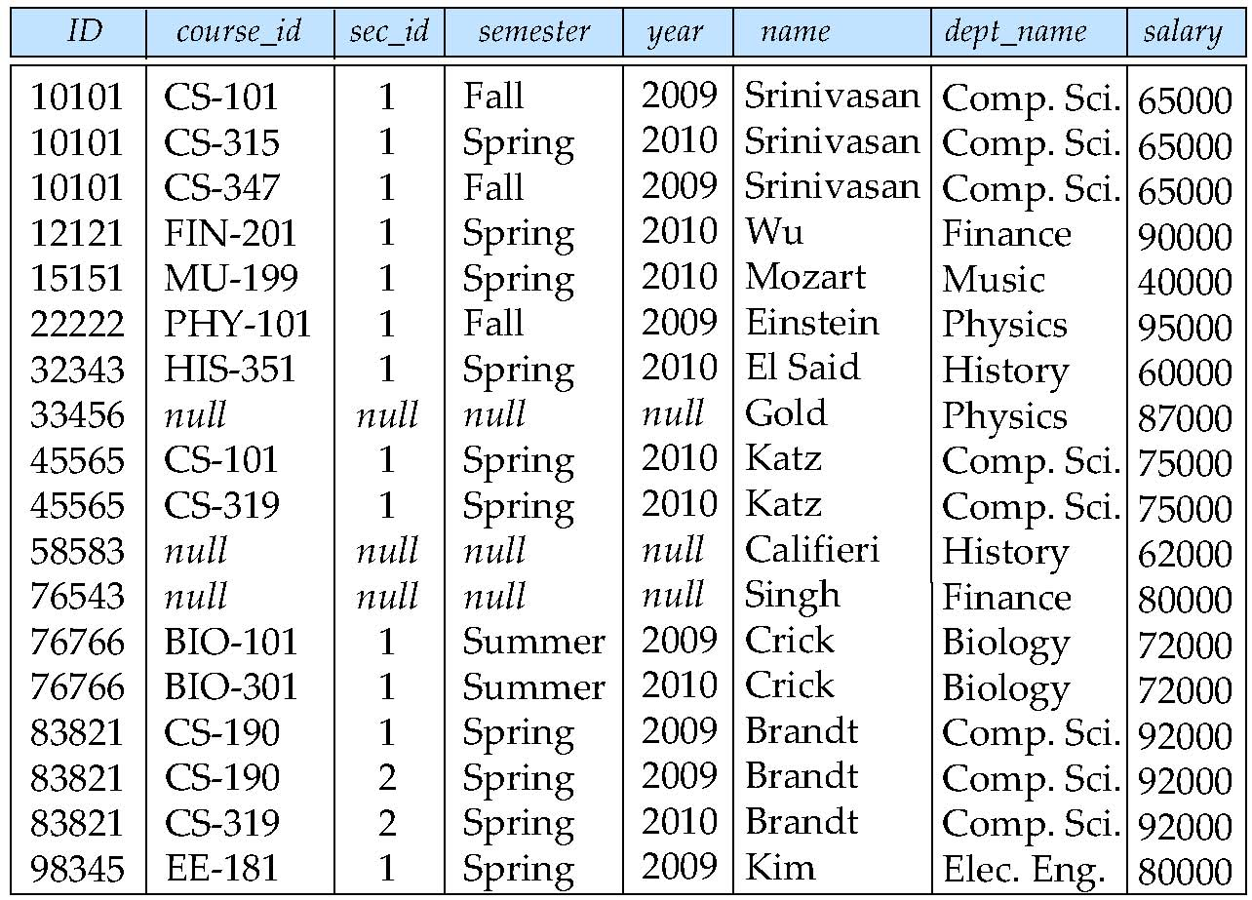
Figure 6.18

Slide 80

Figure 6.19

Slide 81
Figure 6.20

Slide 82
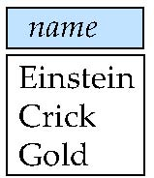
Figure 6.21

Slide 83
Deletion
A delete request is expressed similarly to a query, except instead of displaying tuples to the user, the selected tuples are removed from the database.
Can delete only whole tuples; cannot delete values on only particular attributes
A deletion is expressed in relational algebra by:
r ← r – E
where r is a relation and E is a relational algebra query.

Slide 84
Deletion Examples
Delete all account records in the Perryridge branch.
account ← account – σ _{branch_name = “Perryridge”} (account )
Delete all loan records with amount in the range of 0 to 50
loan ← loan – σ _{amount ≥ 0 and amount ≤ 50} (loan)
Delete all accounts at branches located in Needham.
r₁ ← σ _{branch_city = “Needham”} (account branch )
r₂ ← ∏ _{account_number,} _{branch_name, balance} (r₁)
r₃ ← ∏ _{customer_name, account_number} (r₂ depositor)
account ← account – r₂
depositor ← depositor – r₃

Slide 85
Insertion
To insert data into a relation, we either:
specify a tuple to be inserted
write a query whose result is a set of tuples to be inserted
in relational algebra, an insertion is expressed by:
r ← r ∪ E
where r is a relation and E is a relational algebra expression.
The insertion of a single tuple is expressed by letting E be a constant relation containing one tuple.

Slide 86
Insertion Examples
Insert information in the database specifying that Smith has $1200 in account A-973 at the Perryridge branch.
account ← account ∪ {(“A-973”, “Perryridge”, 1200)}
depositor ← depositor ∪ {(“Smith”, “A-973”)}
Provide as a gift for all loan customers in the Perryridge branch, a $200 savings account. Let the loan number serve as the account number for the new savings account.
r₁ ← (σ_{branch_name = “Perryridge”} (borrower loan))
account ← account ∪ ∏_{loan_number, branch_name, 200} (r₁)
depositor ← depositor ∪ ∏_{customer_name, loan_number} (r₁)

Slide 87
Updating
A mechanism to change a value in a tuple without charging all values in the tuple
Use the generalized projection operator to do this task
Each F_{i} is either
the I ^{th} attribute of r, if the I ^{th} attribute is not updated, or,
if the attribute is to be updated F_{i} is an expression, involving only constants and the attributes of r, which gives the new value for the attribute

Slide 88
Update Examples
Make interest payments by increasing all balances by 5 percent.
account ← ∏ account_number, branch_name, balance * 1.05 (account)
Pay all accounts with balances over $10,000 6 percent interest and pay all others 5 percent
account ← ∏ account_number, branch_name, balance * 1.06 (σ _{BAL > 10000} (account )) ∪ ∏ account_number, branch_name, balance * 1.05 (σ_{BAL ≤ 10000} (account))

Slide 89
Example Queries
Find the names of all customers who have a loan and an account at bank.
∏_{customer_name} (borrower) ∩ ∏_{customer_name} (depositor)
Find the name of all customers who have a loan at the bank and the loan amount
∏customer_name, loan_number, amount (borrower loan)

Slide 90
Example Queries
Find all customers who have an account from at least the “Downtown” and the Uptown” branches.
Query 1
∏_{customer_name} (σ_{branch_name = “Downtown”} (depositor account )) ∩
∏_{customer_name} (σ_{branch_name = “Uptown”} (depositor account))
Query 2
∏_{customer_name, branch_name} (depositor account) ÷ ρ_{temp(branch_name)} ({(“Downtown” ), (“Uptown” )})
Note that Query 2 uses a constant relation.

Slide 91
Bank Example Queries
Find all customers who have an account at all branches located in Brooklyn city.
∏_{customer_name, branch_name} (depositor account) ÷ ∏_{branch_name} (σ_{branch_city = “Brooklyn”} (branch))

Slide 92
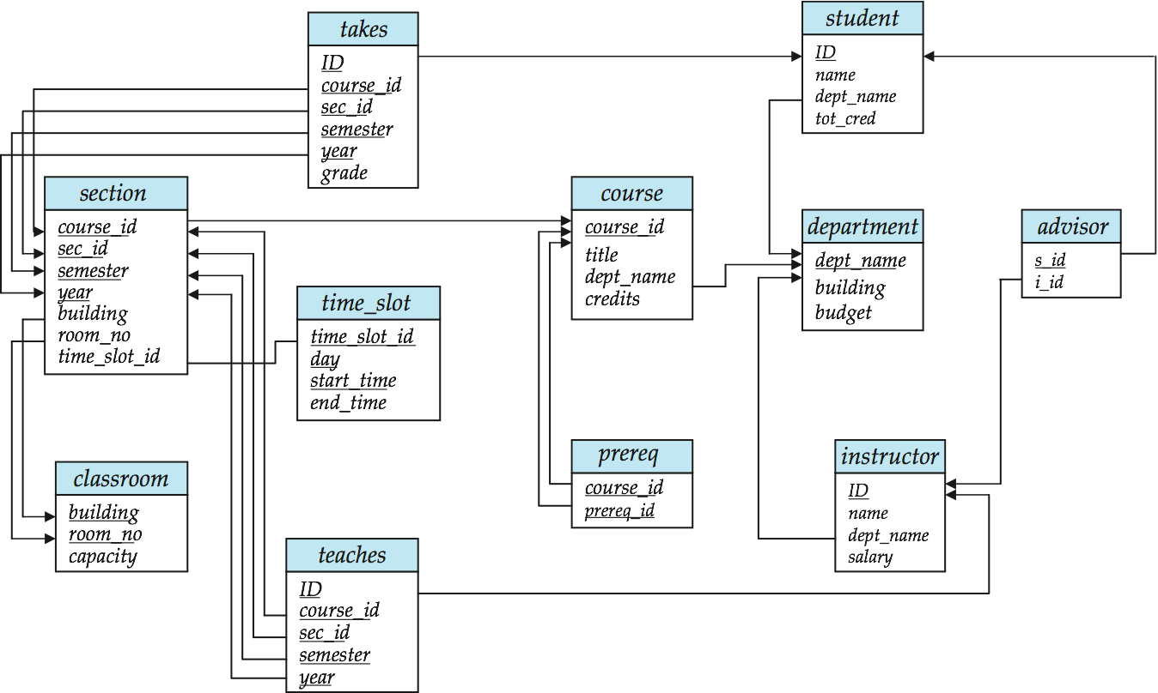
Schema Diagram for University Database

